Slide 1


Slide 2

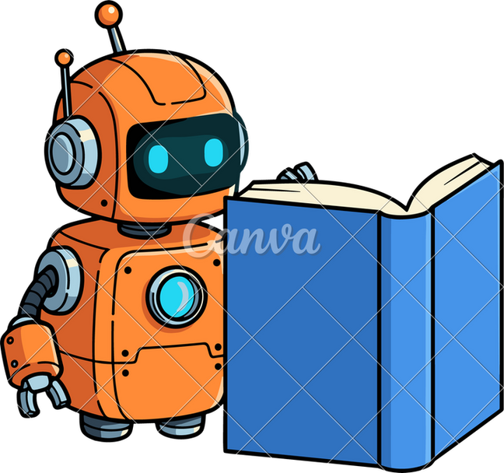
Data Science With Machine Learning

Slide 3


WHAT WE WILL LEARN
What is Data?
Importance of Data in the World?
Use cases of data in the world?
Data Science and Machine Learning ?
Scope of Data Science & Machine Learning?
Why we choose Data Science & machine learning?
Fundamentals of Python.
Life cycle of machine learning and data science project.
Deal with Dataset using python libraries
Training of machine learning algorithm using real world dataset. Get Prediction from algorithm.

Slide 4

DATA
Data refers to a information, or observations that can be
collected, stored, and processed. It can be in the form of numbers, text, images, or any other format. it can reveal patterns, trends,
and valuable information that can be used to make informed decisions or draw conclusions.

Slide 5
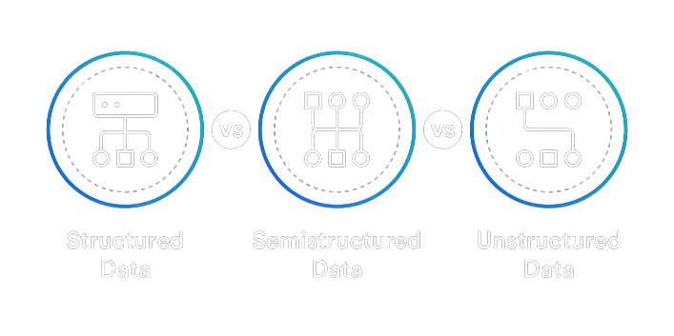
TYPES OF DATA

Slide 6

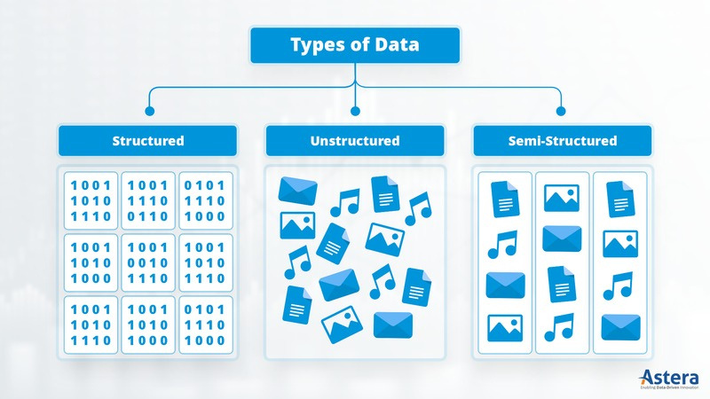

Slide 7



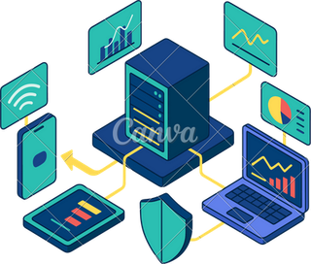


WHAT CAN DATA DO ?
Decision Making
Scientific Research and Development Artificial intelligence and Robotics. Building smart AI enabled software IT and other all in industry
Install AI enabled cameras
Data driven based application Efficiency and Optimization
Business Analytics
Future estimation.
Content Recommendation

Slide 8



DATA SCIENCE
DataScienceisthe fieldof study that focuses on collecting, cleaning,
analyzing, and interpreting data to find useful information and help in decision-making. In Other words, Its multidisciplinary field that uses data, programming, statistics, and machine learning to extract meaningful insights from raw data.
Business Problem
↓
Data Collection
↓
Data Cleaning
↓
Data Exploration (EDA)
↓
Data Visualization
↓
Model Building (ML)
↓
Evaluation
↓
Insights & Decision Making

Slide 9
SCOPE OF AI & DATA SCIENCE
IT industry
Agriculture Department
Healthcare and Medicine Department Artificial intelligence and Robotics Finance and Banking
Marketing and Advertising Manufacturing and Industry Transportation and Logistics E-commerce
And so on…….

Slide 10
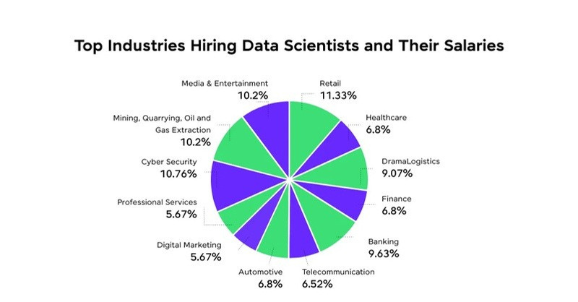
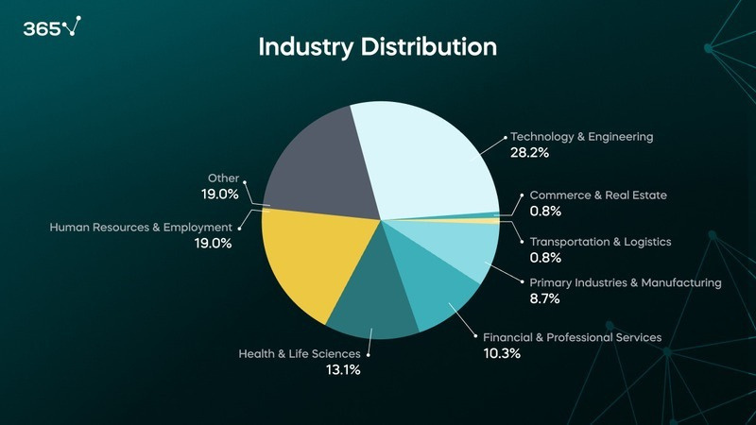
Idea of Jobs Distribution

Slide 11
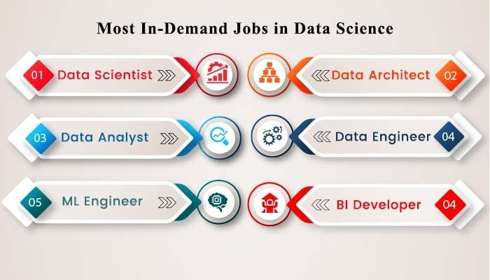
“Data Scientist, the sexiest job title for the 21st century”
Ifyou have everwitnessed a discussion on data science jobs and thejob roles, you have mostly heard the term ‘data scientist’. But is itthe only job profile associated with data science? No, there are many sub-roles that are driving industries of the world.

Slide 12
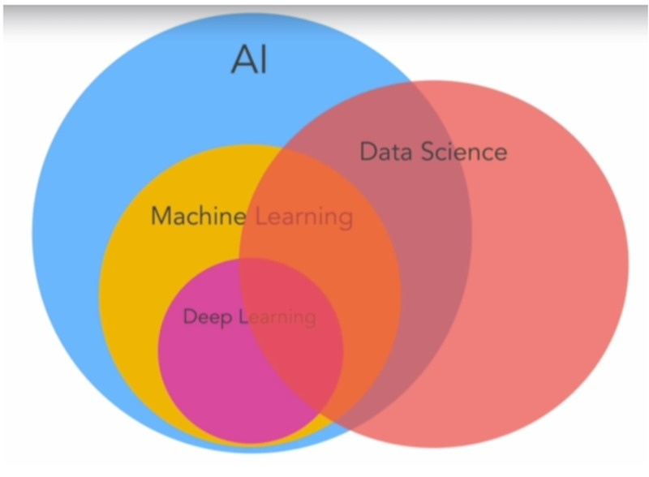
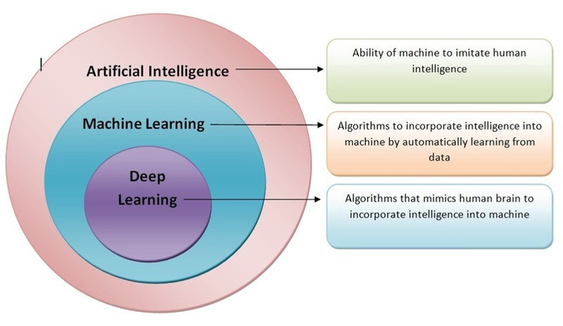
DATA SCIENCE
AI
ML
DL
2000 IGOR
1956 JOHN
1959 ARTHUR

Slide 13

MACHINE LEARNING
Machine learning is the subset of artificial intelligence
(AI) focused on algorithms that can “learn” the patterns of
training data and, subsequently, make
accurate inferences about new data. This pattern
recognition ability enables machine learning models to
make decisions or predictions without explicit, hard-
coded instructions.

Slide 14
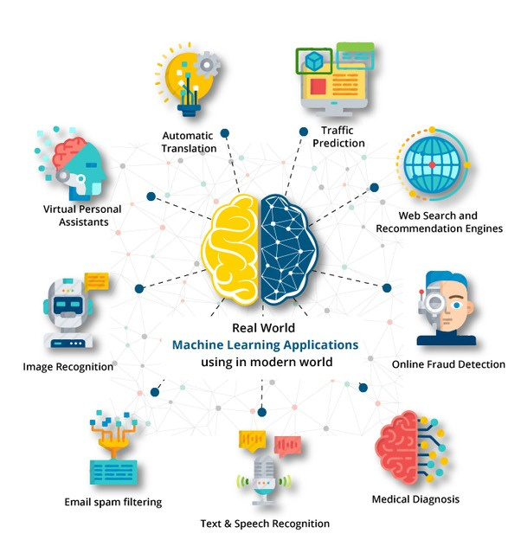
Examples of ML-

Slide 15
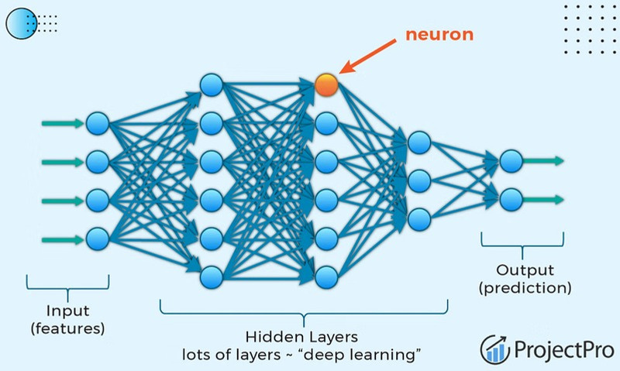
DEEP LEARNING
Deeplearningis a subset of machine learning driven by multilayered neural
networks whose design is inspiredby the structure of the human brain. Deep learning simulates our brain. it is inspired by biological neuron concepts.

Slide 16
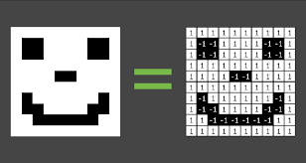
Example of DL-

Slide 17
PYTHON LANGUAGE

Slide 18
WHY PYTHON
1.Design-Philosophy 2.Batteries-Included 3.General Purpose
4.Community/Libraries

Slide 19

PYTHON
Python is a widely used general-purpose, high level programming language. It was
created by Guido van Rossum (cwi=Centrum Wiskunde & Informatica )) in 1991.
Readable and Easy to Learn Object Oriented
Interpreted
High-Level Language Dynamic Typing Cross-platform
large standard library Proximity with Maths

Slide 20
PYTHON USED FOR:
1.Software development 2.Data Science 3.Artificial Intelligence 4.Web Development
5. Automation 6.Machine Learning

Slide 21
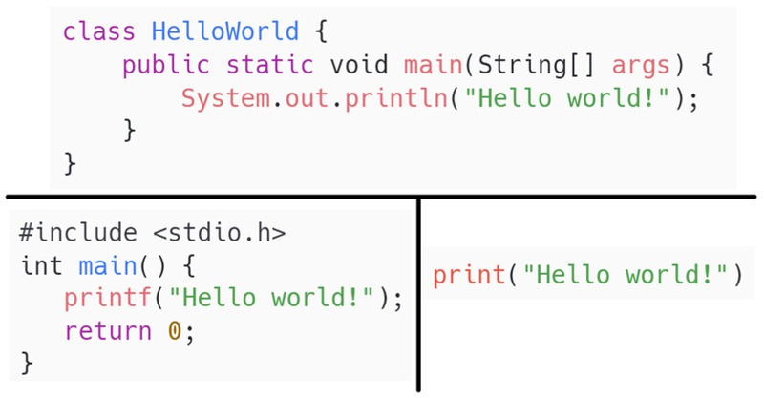
PROGRAM COMPARISON

Slide 22
THANK YOU

